Slide 1
Supervised4 Decision Tree & Random forest
資料科學/Data Science
張家銘/Jia-Ming Chang
政治大學資訊科學系/NCCU.CS
The slide isonly for educational purposes. If any infringement, please contact me, we will correct immediately.

Slide 2
Copyright declaration 版權說明
Some of the figures in this presentation are taken from "An Introduction to Statistical Learning, with applications in R" (Springer, 2013) with permission from the authors: G. James, D. Witten, T. Hastie and R. Tibshirani.
The web site of the book
The credit of individual is indicated in the bottom part of the slide.
ie.,

Slide 3
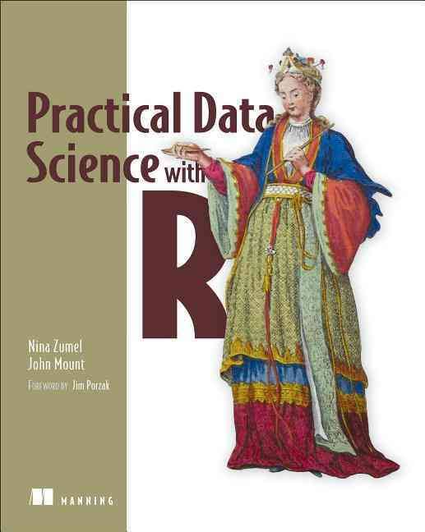
Copyright declaration 版權說明
Some of the figures in this presentation are taken from "Practical Data Science with R" (Manning, 2019)
The web site of the book
The credit of individual is indicated in the bottom part of the slide.
ie.,

Slide 4
Copyright declaration 版權說明
Some of the figures in this presentation are taken from "R for Data Science” under the Creative Commons Attribution-NonCommercial-NoDerivs 3.0 License.
The web site of the book
The credit of individual is indicated in the bottom part.
ie.,

Slide 5
Recap for the last week

Slide 6
Key takeaways
Functional models allow you to better explore how changes in inputs affect predictions.
Linear regression is a good first technique for modeling quantities.
Logistic regression is good first technique for modeling probabilities.
Models with simple forms come with very powerful summaries and diagnostics.
Practical Data Science with R by Nina Zumel, John Mount

Slide 7
Today
Chp. 9: Exploring advanced methods

Slide 8
Weaknesses of the basic approaches
Non-monotone effects
Learning non-monotone relationships with generalized additive models
Training variance
Reducing training variance with bagging and random forests
Linearly inseparable data
Increasing data separation with kernel methods
Modeling complex decision boundaries with support vector machines
Practical Data Science with R by Nina Zumel, John Mount

Slide 9
Training variance
Training variance is when small changes in the makeup of the training set result in models that make substantially different predictions.
Decision trees can exhibit this effect.
Both bagging and random forests can reduce training variance and sensitivity to overfitting.
Practical Data Science with R by Nina Zumel, John Mount

Slide 10
Decision trees

Slide 11
Using decision trees
a procedure to split the training data into pieces and use a simple memorized constant on each piece
involves proposing many possible data cuts and then choosing best cuts based on simultaneous competing criteria of predictive power, cross-validation strength, and interaction with other chosen cuts.
Practical Data Science with R by Nina Zumel, John Mount

Slide 12
Building a decision tree
decisionTree/decisionTree.R
load('KDD2009.Rdata')
library('ROCR')
library('rpart')
fV <- paste(outcome,'>0 ~ ', paste(c(catVars,numericVars),collapse=' + '),sep='')
tmodel <- rpart(fV,data=dTrain)
Practical Data Science with R by Nina Zumel, John Mount

Slide 13
Building a decision tree
decisionTree/decisionTree.R
print(calcAUC(predict(tmodel,newdata=dTrain),dTrain[,outcome]))
print(calcAUC(predict(tmodel,newdata=dTest),dTest[,outcome]))
print(calcAUC(predict(tmodel,newdata=dCal),dCal[,outcome]))
Any problem? Why?
Practical Data Science with R by Nina Zumel, John Mount

Slide 14
Why a bad decision tree?
possible sources of the failure
we have categorical variables with very many levels
we have a lot more NA s/missing data than rpart() ’s surrogate value strategy was designed for.
What we can do to work around
fit on our reprocessed variables, which hide the categorical levels (replacing them with numeric predictions)
remove NA s (treating them as just another level)
Practical Data Science with R by Nina Zumel, John Mount

Slide 15
Why a bad decision tree?
tVars <- paste('pred',c(catVars,numericVars),sep='')
fV2 <- paste(outcome,'>0 ~ ',paste(tVars,collapse=' + '),sep='')
tmodel <- rpart(fV2,data=dTrain)
print(calcAUC(predict(tmodel,newdata=dTrain),dTrain[,outcome]))
print(calcAUC(predict(tmodel,newdata=dTest),dTest[,outcome]))
print(calcAUC(predict(tmodel,newdata=dCal),dCal[,outcome]))
Any problem? Why?
Practical Data Science with R by Nina Zumel, John Mount

Slide 16
Why a bad decision tree?
possible sources of the failure
overfitting is because our model is too complicated
What we can do to work around
tune a bit with the controls by rpart.control
cp: complexity parameter, any split that does not decrease the overall lack of fit by a factor of cp is not attempted (default = 0.01).
Practical Data Science with R by Nina Zumel, John Mount

Slide 17
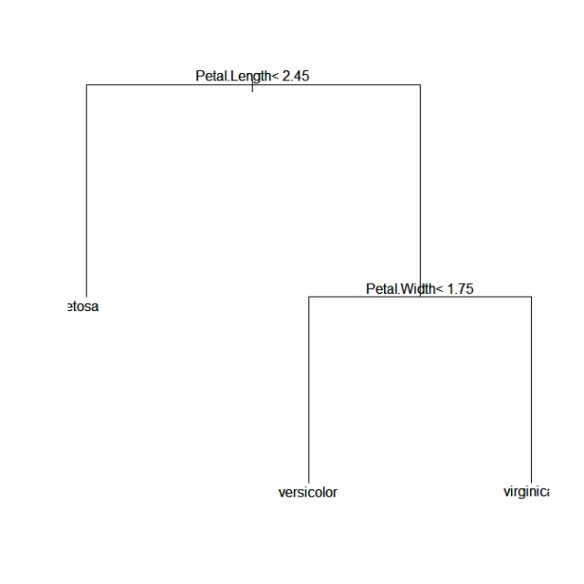
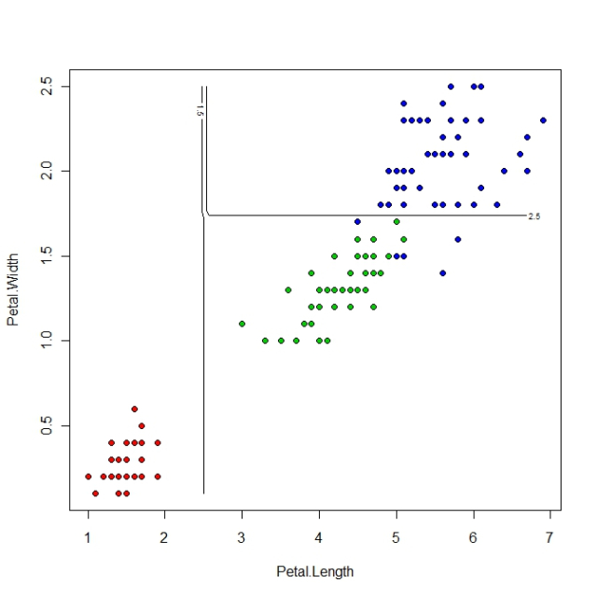
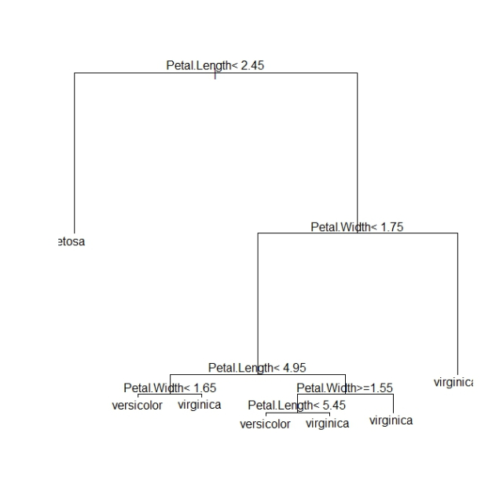
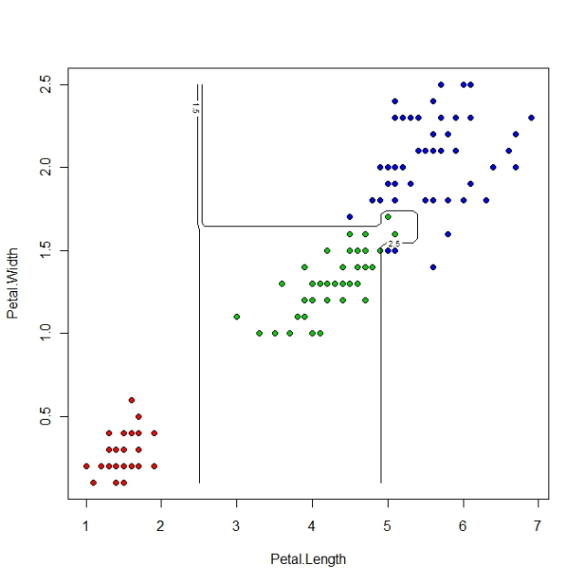
rpart.control(cp=?)
save computing time by pruning off splits that are obviously not worthwhile
any split which does not improve the fit by cp will likely be pruned off by cross-validation, and that hence the program need not pursue it.
cp=0.01
cp=0.001
Credit by 演衡學習筆記, https://c3h3notes.wordpress.com/2010/10/25/r%E4%B8%8A%E7%9A%84cart-package-rpart-%E5%8F%83%E6%95%B8%E7%AF%87/

Slide 18
rpart.control(cp=?)
plotcp(tmodel)
printcp(tmodel)

Slide 19
Why a bad decision tree?
monkey a bit with the controls by rpart.control
minsplit=1000
the minimum # of observations that must exist in a node in order for a split to be attempted
minbucket=1000
the minimum # of observations in any terminal leaf node.
If only one of minbucket or minsplit is specified, the code either sets
minsplit = minbucket*3
minbucket = minsplit/3
maxdepth=5
the maximum depth of any node of the final tree, with the root node counted as depth=0
Practical Data Science with R by Nina Zumel, John Mount

Slide 20
Why a bad decision tree?
tmodel <- rpart(fV2,data=dTrain, control=rpart.control(cp=0.001,minsplit=1000, minbucket=1000,maxdepth=5))
print(calcAUC(predict(tmodel,newdata=dTrain),dTrain[,outcome]))
print(calcAUC(predict(tmodel,newdata=dTest),dTest[,outcome]))
print(calcAUC(predict(tmodel,newdata=dCal),dCal[,outcome]))
Any problem? Why?
Practical Data Science with R by Nina Zumel, John Mount

Slide 21
Why a bad decision tree?
possible sources of the failure
this dataset is unsuitable for decision trees and a method that deals better with overfitting issues is needed—such as random forests
What we can do to work around
using decision trees was from using our selected variables (instead of all transformed variables)
Practical Data Science with R by Nina Zumel, John Mount

Slide 22
Variable selection
logLikelyhood <- function(outCol,predCol) {
sum(ifelse(outCol==pos,log(predCol),log(1-predCol)))
}
selVars <- c()
minStep <- 5
baseRateCheck <- logLikelyhood(dCal[,outcome], sum(dCal[,outcome]==pos)/length(dCal[,outcome]))
Practical Data Science with R by Nina Zumel, John Mount

Slide 23
Cat variable selection
for(v in catVars) {
pi <- paste('pred',v,sep='')
liCheck <- 2*((logLikelyhood(dCal[,outcome],dCal[,pi]) -
baseRateCheck))
if(liCheck>minStep) {
print(sprintf("%s, calibrationScore: %g",
pi,liCheck))
selVars <- c(selVars,pi)
}
}
Practical Data Science with R by Nina Zumel, John Mount

Slide 24
Num variable selection
for(v in numericVars) {
pi <- paste('pred',v,sep='')
liCheck <- 2*((logLikelyhood(dCal[,outcome],dCal[,pi]) -
baseRateCheck) - 1)
if(liCheck>=minStep) {
print(sprintf("%s, calibrationScore: %g",
pi,liCheck))
selVars <- c(selVars,pi)
}
}
Practical Data Science with R by Nina Zumel, John Mount

Slide 25
Why a bad decision tree?
f <- paste(outcome,'>0 ~ ',paste(selVars,collapse=' + '),sep='')
tmodel <- rpart(f,data=dTrain, control=rpart.control(cp=0.001,minsplit=1000, minbucket=1000,maxdepth=5))
print(calcAUC(predict(tmodel,newdata=dTrain),dTrain[,outcome]))
print(calcAUC(predict(tmodel,newdata=dTest),dTest[,outcome]))
print(calcAUC(predict(tmodel,newdata=dCal),dCal[,outcome]))
trying different settings of the method argument
Practical Data Science with R by Nina Zumel, John Mount

Slide 26
How decision tree models work?
print(tmodel)
How many nodes?
What does * mean?
Why node is not ordered by continuous number?
the parent of node k is node floor(k/2)
Practical Data Science with R by Nina Zumel, John Mount

Slide 27
How decision tree models work?
print(tmodel)
three numbers reported for each node
# of training items that navigated to the node
the deviance of the set of training items that navigated to the node (a measure of how much uncertainty remains at a given decision tree node)
the fraction of items that were in the positive class at the node (which is the prediction for leaf nodes)
Practical Data Science with R by Nina Zumel, John Mount

Slide 28
deviance
-2*(logLikelihood-S)
where S is a technical constant called “the log likelihood of the saturated model.
With S =0, the deviance can be used to calculate a pseudo R-squared (see http://mng.bz/j338).
1 - deviance(model)/deviance(null model)
What is the psedudo R-square of the spam model?
Practical Data Science with R by Nina Zumel, John Mount

Slide 29
Plotting the decision tree
par(cex=0.7)
plot(tmodel)
text(tmodel)
Practical Data Science with R by Nina Zumel, John Mount

Slide 30
Advantage : decision tree
They take any type of data, numerical or categorical, without any distributional assumptions and without preprocessing.
Most implementations (in particular, R’s) handle missing data; the method is also robust to redundant and nonlinear data.
Practical Data Science with R by Nina Zumel, John Mount

Slide 31
Advantage : decision tree
The algorithm is easy to use, and the output (the tree) is relatively easy to understand.
Once the model is fit, scoring is fast.
Practical Data Science with R by Nina Zumel, John Mount

Slide 32
Drawbacks : decision tree
They have a tendency to overfit, especially without pruning.
They have high training variance: samples drawn from the same population can produce trees with different structures and different prediction accuracy.
Prediction accuracy can be low, compared to other methods.
Practical Data Science with R by Nina Zumel, John Mount

Slide 33
Solution for the drawbacks of the decision tree
bagging is often used to improve decision tree models
random forests directly combines decision trees with bagging
Practical Data Science with R by Nina Zumel, John Mount

Slide 34
Ensemble learning

Slide 35
Ensemble learning
An ensemble model is composed of the combination of several smaller simple models (often small decision trees).
Bagging
Random forests
Practical Data Science with R by Nina Zumel, John Mount

Slide 36
Using bagging to improve prediction
draw bootstrap samples (random samples with replacement) from your data.
From each sample, build a decision tree model
x is an input datum, y_{i}(x) is the output of the ith tree
Practical Data Science with R by Nina Zumel, John Mount

Slide 37
Using bagging to improve prediction
The final model is the average of all the individual decision trees
c(y₁(x), y₂(x), ... ,y_{n}(x)) is the vector of individual outputs
y is the output of the final model
Practical Data Science with R by Nina Zumel, John Mount

Slide 38
Final model by using bagging
For regression, or for estimating class probabilities
y(x) is the average of the scores returned by the individual trees
y(x) = mean( c(y₁(x), ..., y_{n}(x)) )
For classification
the final model assigns the class that got the most votes from the individual trees
Practical Data Science with R by Nina Zumel, John Mount

Slide 39
Using bagging to improve prediction
Bagging decision trees stabilizes the final model by lowering the variance
A bagged ensemble of trees is also less likely to overfit the data.
Practical Data Science with R by Nina Zumel, John Mount

Slide 40
Spam mail data

Slide 41
Building and applying a logistic regression spam model
Spambase dataset ( http://mng.bz/e8Rh )
https://raw.githubusercontent.com/WinVector/zmPDSwR/master/Spambase/spamD.tsv
spamExam.R
# load data
spamD <- read.table('spamD.tsv',header=T,sep='\t')
spamTrain <- subset(spamD,spamD$rgroup>=10)
spamTest <- subset(spamD,spamD$rgroup<10)
spamVars <- setdiff(colnames(spamD),list('rgroup','spam'))
Practical Data Science with R by Nina Zumel, John Mount

Slide 42
Building and applying a logistic regression spam model
# build model
spamFormula <- as.formula(paste('spam=="spam"', paste(spamVars,collapse=' + '),sep=' ~ '))
spamModel <- glm(spamFormula,family=binomial(link='logit'), data=spamTrain)
Practical Data Science with R by Nina Zumel, John Mount

Slide 43
Building and applying a logistic regression spam model
# print predicted result
print(with(spamTest,table(y=spam,glmPred=pred>0.5)))
sample <- spamTest[c(7,35,224,327),c('spam','pred')]
print(sample)
Practical Data Science with R by Nina Zumel, John Mount

Slide 44
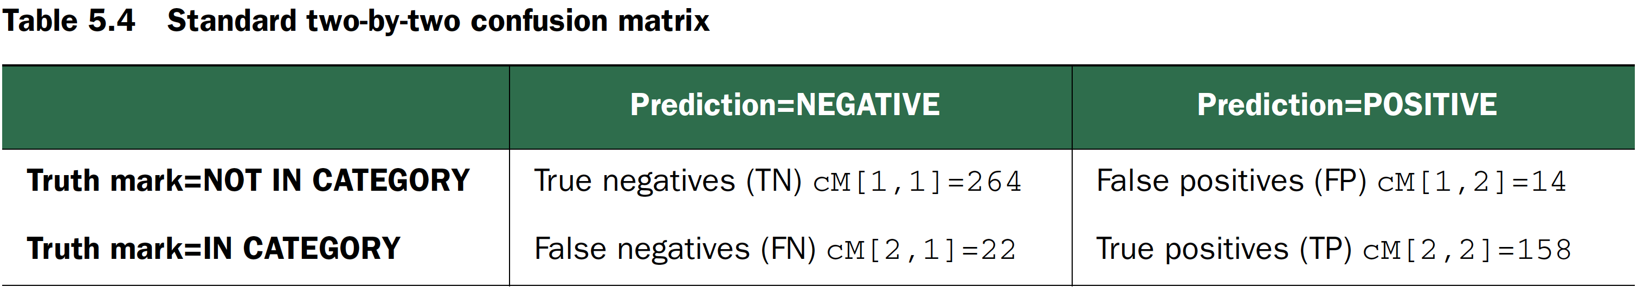
Spam confusion matrix
cM <- table(truth=spamTest$spam, prediction=spamTest$pred>0.5)
print(cM)
## prediction
## truth FALSE TRUE
## non-spam 264 14
## spam 22 158
Practical Data Science with R by Nina Zumel, John Mount

Slide 45
Preparing Spambase data
ensembleLearning/bag.R
spamD <- read.table('spamD.tsv',header=T,sep='\t')
spamTrain <- subset(spamD,spamD$rgroup>=10)
spamTest <- subset(spamD,spamD$rgroup<10)
spamVars <- setdiff(colnames(spamD),list('rgroup','spam'))
spamFormula <- as.formula(paste('spam=="spam"',paste(spamVars,collapse=' + '),sep=' ~ '))
Practical Data Science with R by Nina Zumel, John Mount

Slide 46
Defining performance
loglikelihood <- function(y, py) {
pysmooth <- ifelse(py==0, 1e-12,
ifelse(py==1, 1-1e-12, py))
sum(y * log(pysmooth) + (1-y)*log(1 - pysmooth))
}
Practical Data Science with R by Nina Zumel, John Mount

Slide 47
Defining performance
accuracyMeasures <- function(pred, truth, name="model") {
dev.norm <- -2*loglikelihood(as.numeric(truth), pred)/length(pred)
ctable <- table(truth=truth, pred=(pred>0.5))
accuracy <- sum(diag(ctable))/sum(ctable)
precision <- ctable[2,2]/sum(ctable[,2])
recall <- ctable[2,2]/sum(ctable[2,])
f1 <- precision*recall
data.frame(model=name, accuracy=accuracy, f1=f1, dev.norm)
}
Practical Data Science with R by Nina Zumel, John Mount

Slide 48
Evaluate the performance of decision trees
library(rpart)
treemodel <- rpart(spamFormula, spamTrain)
accuracyMeasures(predict(treemodel, newdata=spamTrain), spamTrain$spam=="spam", name="tree,training")
accuracyMeasures(predict(treemodel, newdata=spamTest), spamTest$spam=="spam", name="tree,test")
Practical Data Science with R by Nina Zumel, John Mount

Slide 49
apply
X<-matrix(rnorm(30), nrow=5, ncol=6)
apply(X,2 ,sum)

Slide 50
lapply vs sapply
lapply(X, FUN, …)
returns a list of the same length as X, each element of which is the result of applying FUN to the corresponding element of X
sapply(X, FUN, …)
a user-friendly version and wrapper of lapply by default returning a vector, matrix or, if simplify = "array", an array if appropriate

Slide 51
sapply
sapply works as lapply, but it tries to simplify the output to the most elementary data structure that is possible
A<-matrix(1:9, 3,3)
B<-matrix(4:15, 4,3)
C<-matrix(8:10, 3,2)
MyList<-list(A,B,C) # display the list
lapply(MyList,"[", 2,1 )
sapply(MyList,"[", 2,1 )

Slide 52
Bagging decision trees
Use bootstrap samples the same size as the training set, with 100 trees
ntrain <- dim(spamTrain)[1]
n <- ntrain
ntree <- 100
Build the bootstrap samples by sampling the row indices of spamTrain with replacement
samples <- sapply(1:ntree, FUN = function(iter) {sample(1:ntrain, size=n, replace=T)})
Practical Data Science with R by Nina Zumel, John Mount

Slide 53
Bagging decision trees
Train the individual decision trees and return them in a list.
treelist <-lapply(1:ntree, FUN=function(iter) {samp <- samples[,iter]; rpart(spamFormula, spamTrain[samp,])})
Practical Data Science with R by Nina Zumel, John Mount

Slide 54
Bagging decision trees
predict.bag assumes the underlying classifier returns decision probabilities, not decisions
predict.bag <- function(treelist, newdata) {
preds <- sapply(1:length(treelist), FUN=function(iter) { predict(treelist[[iter]], newdata=newdata)})
predsums <- rowSums(preds)
predsums/length(treelist)
}
Practical Data Science with R by Nina Zumel, John Mount

Slide 55
Measure Bagging decision trees
accuracyMeasures(predict.bag(treelist, newdata=spamTrain), spamTrain$spam=="spam",name="bagging, training")
accuracyMeasures(predict.bag(treelist, newdata=spamTest), spamTest$spam=="spam", name="bagging, test")
model accuracy f1 dev.norm
1 bagging, training 0.9234854 0.8105411 0.4684622 model accuracy f1 dev.norm
1 bagging, test 0.9126638 0.7806259 0.5297942 model accuracy f1 dev.norm
1 tree,training 0.9104514 0.7809002 0.5618654
model accuracy f1 dev.norm
1 tree,test 0.8799127 0.7091151 0.6702857
Practical Data Science with R by Nina Zumel, John Mount

Slide 56
Measure Bagging decision trees
The improvement is more dramatic on the test set: the bagged model has less generalization error than the single decision tree
Generalization error = the difference in accuracy of the model on data it’s never seen before, as compared to its error on the training set.
Practical Data Science with R by Nina Zumel, John Mount

Slide 57
Random Forest

Slide 58
Using random forests to further improve prediction
Motivation
In bagging, each tree is built by considering the exact same set of features.
Hence, the individual trees will tend to be overly correlated with each other.
If there are regions in feature space where one tree tends to make mistakes, then all the trees are likely to make mistakes there.
Practical Data Science with R by Nina Zumel, John Mount

Slide 59
Using random forests to further improve prediction
The random forest approach tries to de-correlate the trees by randomizing the set of variables that each tree is allowed to use.
Practical Data Science with R by Nina Zumel, John Mount

Slide 60
random forest method
Draws a bootstrapped sample from the training data
For each sample, grows a decision tree, and at each node of the tree
Randomly draws a subset of m variables from the total features
Picks the best variable and the best split from that set of m variables
Continues until the tree is fully grown
The final ensemble of trees is then bagged to make the random forest predictions
Practical Data Science with R by Nina Zumel, John Mount

Slide 61
random forest method
Randomly draws a subset of m variables from the p total features
randomForest() function
for regression trees : m = p/3
for classification trees : m = sqrt(p)
In theory, random forests aren’t terribly sensitive to the value of m
If you have a very large number of variables to choose from, of which only a small fraction are actually useful, then using a larger m is better.
Practical Data Science with R by Nina Zumel, John Mount

Slide 62
Using random forests
library(randomForest)
set.seed(5123512)
fmodel <- randomForest(x=spamTrain[,spamVars], y=spamTrain$spam, ntree=100, nodesize=7, importance=T)
Specify that each node of a tree must have a minimum of 7 elements, to be compatible with the default minimum node size that rpart() uses on this training set
Practical Data Science with R by Nina Zumel, John Mount

Slide 63
Using random forests
accuracyMeasures(predict(fmodel, newdata=spamTrain[,spamVars],type='prob')[,'spam'], spamTrain$spam=="spam",name="random forest, train")
accuracyMeasures(predict(fmodel, newdata=spamTest[,spamVars],type='prob')[,'spam'], spamTest$spam=="spam",name="random forest, test")
Practical Data Science with R by Nina Zumel, John Mount

Slide 64
Spam data by decision tree, bagging, random forest
Performance on the training set and the test set
 | accuracy |  | f1 |  | dev.norm
model | training | test | training | test | training | test
Tree | 0.9104514 | 0.8799127 | 0.7809002 | 0.7091151 | 0.5618654 | 0.6702857
Bagging | 0.9220372 | 0.9061135 | 0.8072953 | 0.7646497 | 0.4702707 | 0.5282290
Random Forest | 0.9884142 | 0.9541485 | 0.9706611 | 0.8845029 | 0.1428786 | 0.3972416
Performance change : training - test
model | △accuracy | △f1 | △dev.norm
Tree | 0.03053870 | 0.07178505 | -0.10842030
Bagging | 0.01592363 | 0.04264557 | -0.05795832
Random Forest | 0.03426572 | 0.08615813 | -0.254363

Slide 65
Examining variable importance
To estimate the importance of a variable v
the variable’s values are randomly permuted in the out-of-bag samples, and the corresponding decrease in each tree’s accuracy is estimated
the average decrease over all the trees is large, then the variable is considered important
varImp <- importance(fmodel)
head(varImp)
varImpPlot(fmodel, type=1)
Practical Data Science with R by Nina Zumel, John Mount

Slide 66
Fitting with fewer variables
reduce the number of variables in this spam example from 1 to 25
selVars <- names(sort(varImp[,1], decreasing=T))[1:25]
fsel <- randomForest(x=spamTrain[,selVars],y=spamTrain$spam, ntree=100, nodesize=7, importance=T)
Practical Data Science with R by Nina Zumel, John Mount

Slide 67
Fitting with fewer variables
accuracyMeasures(predict(fsel, newdata=spamTrain[,selVars],type='prob')[,'spam'], spamTrain$spam=="spam",name="RF small, train")
accuracyMeasures(predict(fsel, newdata=spamTest[,selVars],type='prob')[,'spam'], spamTest$spam=="spam",name="RF small, test")
Practical Data Science with R by Nina Zumel, John Mount

Slide 68
Boosting

Slide 69
Boosting
Credit By Sirakorn - Own work, CC BY-SA 4.0, https://commons.wikimedia.org/w/index.php?curid=85888769

Slide 70
Boosting
Most boosting algorithms consist of iteratively learning weak classifiers with respect to a distribution and adding them to a final strong classifier.
When they are added, they are weighted in a way that is related to the weak learners' accuracy. After a weak learner is added, the data weights are readjusted, known as "re-weighting".
Misclassified input data gain a higher weight and examples that are classified correctly lose weight. Thus, future weak learners focus more on the examples that previous weak learners misclassified.

Slide 71
Boosting algorithm
https://liyanxu.blog/2018/10/29/adaboost-and-forward-stagewise-additive-modeling/

Slide 72
Ensemble classifiers, G(x)
Credit by https://towardsdatascience.com/understanding-adaboost-2f94f22d5bfe

Slide 73
A Boosting example
Credit by Tommy Hunag, 機器學習: Ensemble learning之Bagging、Boosting和AdaBoost, https://chih-sheng-huang821.medium.com/

Slide 74
Boosting
https://rpubs.com/skydome20/R-Note16-Ensemble_Learning

Slide 75
eXtreme Gradient Boosting (XGBoost)

Slide 76
Bagging and random forest takeaways
Bagging stabilizes decision trees and improves accuracy by reducing variance.
Bagging reduces generalization error.
Random forests further improve decision tree performance by de-correlating the individual trees in the bagging ensemble.
Practical Data Science with R by Nina Zumel, John Mount

Slide 77
Bagging and random forest takeaways
Random forests’ variable importance measures can help you determine which variables are contributing the most strongly to your model.
Be sure to evaluate the model on holdout data to get a better estimate of model performance.
Practical Data Science with R by Nina Zumel, John Mount

Slide 78
Bagging and random forest takeaways
Because the trees in a random forest ensemble are unpruned and potentially quite deep, there’s still a danger of overfitting
limiting how deep the trees can be grown by using the maxnodes parameter in randomForest()
Practical Data Science with R by Nina Zumel, John Mount

Slide 79


Thank You Any Question?

